Slide 2
Aerial View
Existing Site
Subject Site
City Lot

Slide 3
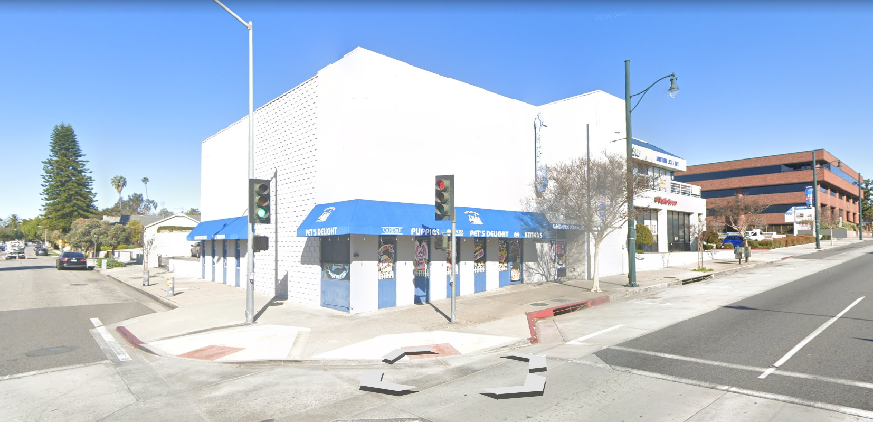
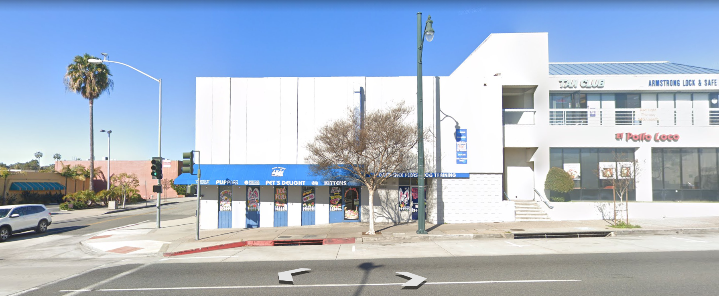
Street Views
From corner of Fair Oaks Avenue and Hope Street, Looking Northwest
From Fair Oaks Avenue, Looking West

Slide 4
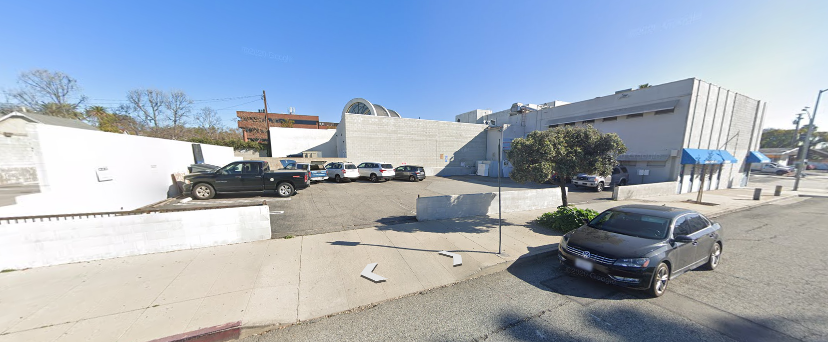
Street Views
From Hope Street, looking north to parking lot and rear of building

Slide 5
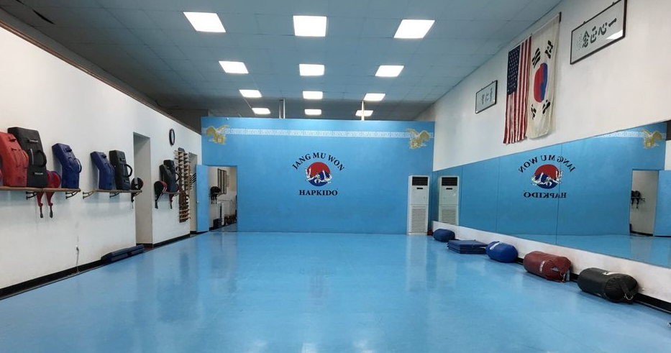
Proposed Operations
Conditional Use Permit would allow the operation of a martial arts studio
Administrative Use Permit is required due to the parking on-site being
non-conforming- required to approve CUP
Provide martials arts instruction to youths age 4 through adults
5-8 students per class short-term; applicant seeking approval for class size up to 20 students
Applicant seeking approval to operate from 9am to 9pm seven days per week should demand arise in the future; however, anticipated operating hours are:
Monday-Friday: 3pm to 9pm Saturdays: 9am to 2pm Sundays: Closed

Slide 6
General Plan Consistency
Site is designated General Commercial and is within the Fair Oaks Avenue Corridor in the Upper Fair Oaks subarea. General Commercial land use provides for a variety of uses including service uses
Zoning Consistency
Site is zoned Commercial General (CG). Studios, including dance, martial arts, music, and photography studios, are conditionally permitted
Use has operated in same zone in close proximity for nearly 30 years
Has provided a service to the community by allowing for physical fitness and self-defense training
Studio infuses people into the commercial area and provides interest from the street
Conditions of approval provide tools to regulate operations for compatibility with surrounding residents and businesses

Slide 7
Parking
SPMC requires multi-tenant buildings to provide parking for the aggregate number of parking spaces required for each separate use
Site is deficient by 4 parking spaces
SPMC allows for changes of use with nonconforming parking to a more intense use with an Administrative Use Permit (AUP).
Required findings can be supported for following reasons:
Lack of overlap in parking demand with the upstairs tenant
Lowered parking demand per student (many parents drop off students and don’t park at the facility. Also, multiple children/family members from one household often attend at the same session)
Adjacent on-street parking for pickup/drop-off
City-owned parking lot nearby
Reduced parking demand as some patrons walk to classes
Ability of the City to put conditions of approval on the operations to correct parking-related problems should they arise

Slide 8
Mandatory Findings
In order to approve the Conditional Use Permit and Administrative Use Permit, the Planning Commission must make findings which are summarized below:
The use is allowed within the zoning district and complies code
The use is consistent with the General Plan and applicable specific plan(s);
The use would not be detrimental to public health, safety, or general welfare
The use would not be detrimental or injurious to property and improvements
The subject site is adequate to accommodate the use and adequately served from a traffic standpoint
The design, location, operating characteristics, and size of the proposed use would be compatible with the existing and future land uses in the vicinity, in terms of aesthetics, character, scale, and impacts on neighboring properties

Slide 9
CEQA – Environmental Analysis
The project is categorically exempt from CEQA pursuant to the following:
Section 15301 - Class 1 - Existing Facilities

Slide 10
Staff Recommendation
Approve the Conditional Use Permit and Administrative Use Permit, subject to conditions of approval.
Planning Commission Options - Alternatives to Staff Recommendation:
Approve the project with modified/added conditions; or
Continue the project to address comments discussed; or
Deny the project.

Slide 11
Questions?

