Slide 1

Notes:
Good evening, Chair and Commissioners, my name is Candida Neal, I am a contract planner for the City of South Pasadena
Before you tonight is Project No. 2341 which is a request for a Hillside Development Permit, Design Review and Variance to construct a single family home on a vacant lot at 807 Rollin Street.
You will also be considering a Tree Removal Permit to allow removal of 5 trees and the relocation of one tree on site, subject to Public Works conditions.
The applicant is, Adrian Dahl, Dahl Architects. Also, attending the meeting are the property owners Wendy Mak and her husband Hong Ho.

Slide 2
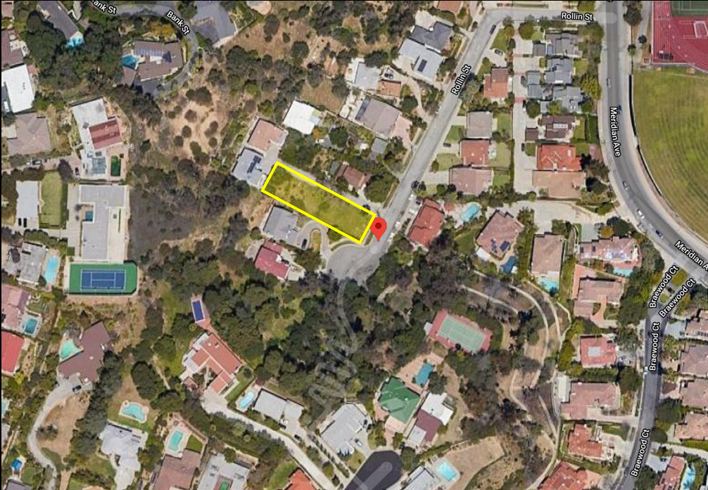
    Aerial View
N
Notes:
The project site is generally located west of Meridian Avenue and south of Monterey Road
surrounded by single-family residences, the vacant lot is in close proximity to South Pasadena High School
On the aerial photo you can see that the site, outlined in yellow, is directly adjacent to the cul de sac at the south end of Rollin Street

Slide 3
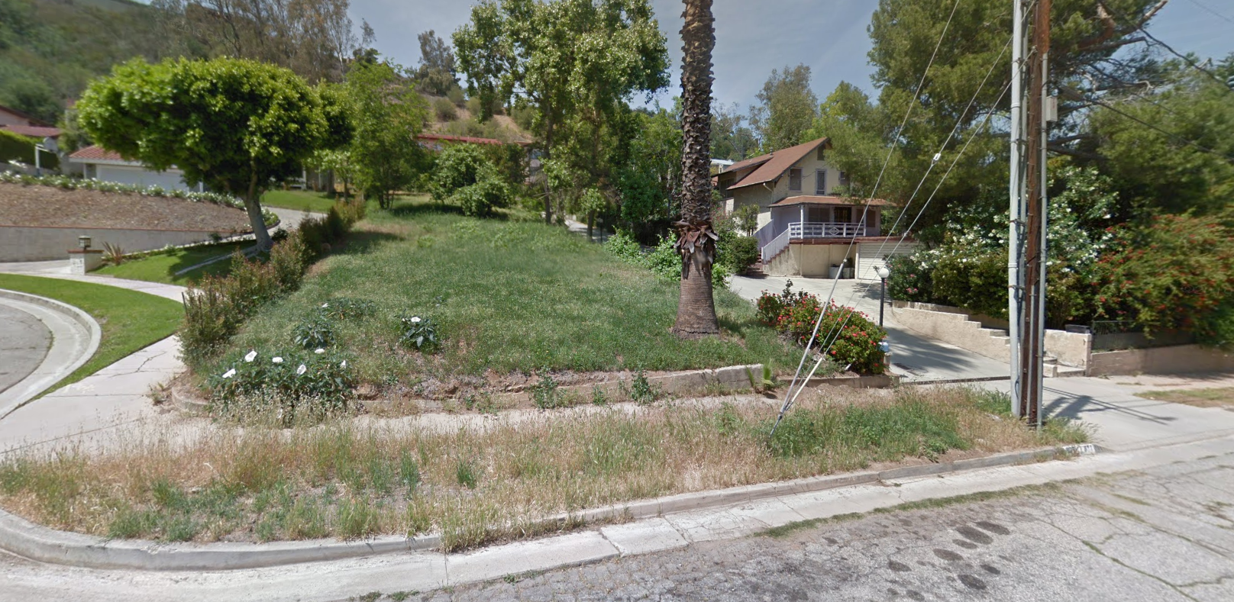
    Street View
Looking west, from Rollin Street
Notes:
Originally purchased by CalTrans for the extension of the 710 freeway when the freeway project was abandoned, the site and the neighboring property to the north were subdivided
The subdivision created a 20-foot private driveway between the two existing lots and two additional residential parcels at the end of the driveway.
Surrounded by homes that were constructed in the 1960s and 1970s, The site slopes upward away from the street and is higher in the center than along the north and south property lines.
The geotechnical report indicates that the mound in the center of the lot was created when developing properties in the area used the 807 Rollin site to offload soil from their grading.
Please notice on the right the private driveway and residence to the north of the site and on the left the cul de sac bulb and the neighboring home to the rear of the lot.

Slide 4
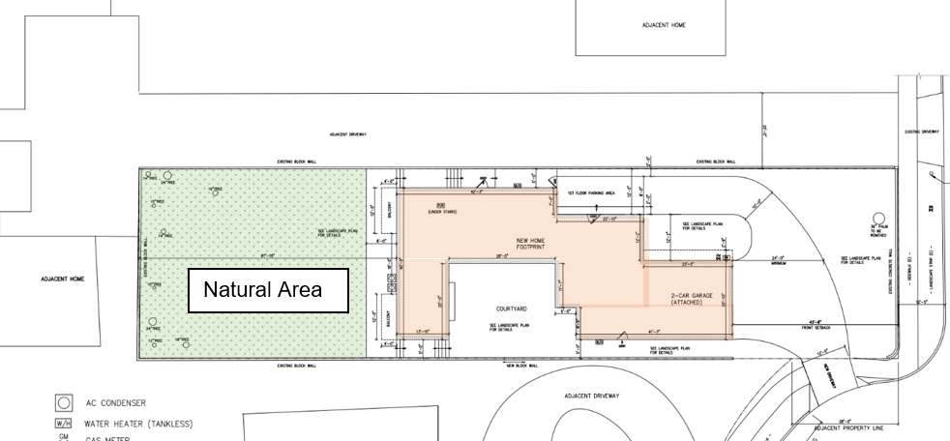
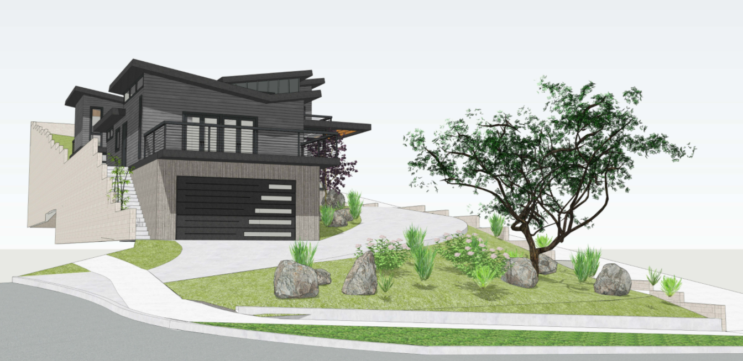
    Project Description
Lot:
9,970 sf
22.1% slope
House:
3,411 sf
3 levels
Attached garage:
2-car
538 sf
Detail of Site Plan
Architectural Rendering
Notes:
The modern courtyard home, shown in pink on the site plan, consists of three levels which follow the slope of the lot up the hillside,
The design and location of the new home are sensitive to preserving the privacy of the neighboring residences.
Notice how The new house steps away from the north property line increasing the distance between the home on the other side of the private drive. On the south side location of new home is east of the neighboring home to the south. The natural open space shown in green is located between the new home and the existing residence to the west.
Side driveway access is provided from the cul de sac bulb. LOWER RT HD CORNER OF THE SITE PLAN. And in the rendering below. Locating the curb cut from the side of the lot creates an uninterrupted landscaped frontage. .
Approximately 23% of the lot, will be left ungraded and in a natural state. Although the landscaped area in front of the house SHOWN IN THE RENDERING will be landscaped with plants native to California, it will be graded and as a result does not satisfy the criteria for natural state and a variance has been requested to reduce percentage of the lot required to be left in a natural state.
With the exception of the variance, the project complies with the General Plan, the Zoning Code, and the City’s adopted design guidelines for new residential construction and hillside development.

Slide 5
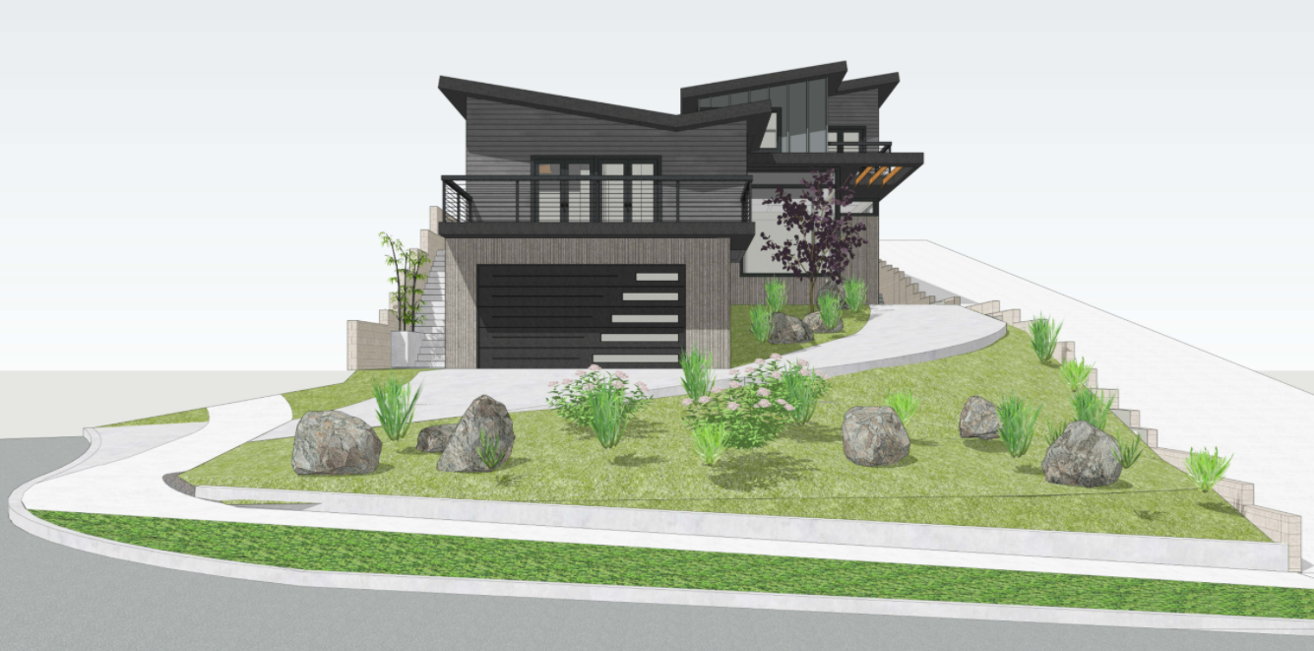
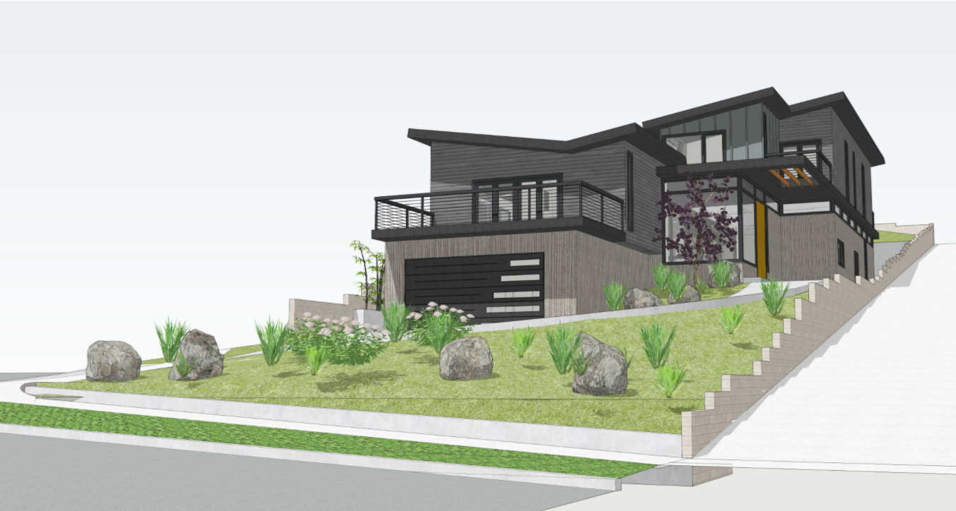
    Design Review – Roof and Cladding
East (Front) Elevation-
From Street
East (Front) Elevation-
From Northeast Corner of Lot
Notes:
The modern style home is clad in horizontal Hardie Plank, vertical standing seam metal siding, vertical board formed concrete textured siding. The variety of materials breaks up the wall into smaller modules and creating interest and variety. The extensive use of glass windows and doors surrounding the courtyard bring the outdoors into the home.
The roof design, probably the most dramatic element of the home, incorporates a combination of shed and reverse gable or “butterfly” roofs, with 2’ eave overhangs and a 2:12 pitch. There are multiple different levels and sections of roof that vary from front to back.

Slide 6
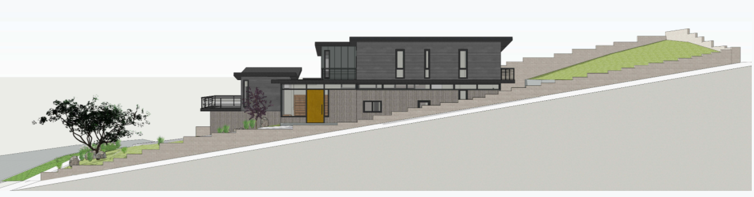
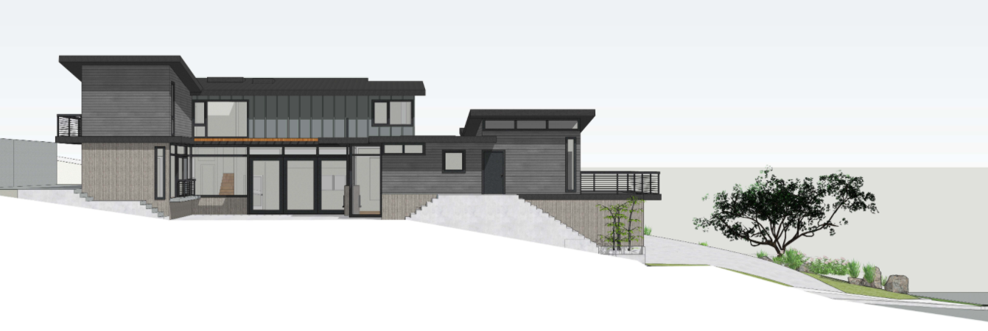
    Design Review – Levels and Height
North (Side) Elevation
South (Side) Elevation
Notes:
In these elevations, you can see how privacy was a priority for the family. The North Elevation, the upper drawing, steps back from the north property line. Windows are designed to provide light and air but not to frame vistas. The South Elevation shows the walls of glass surrounding the courtyard which is located east and down slope of the adjacent neighbor’s home.
The goal of height restrictions in the Zoning Code is to ensure that the building form follows the natural slope. It does this by establishing the maximum height level in relationship to the existing grade or the pre-grading grade.
Maximum building height is based on the roof pitch, for structures, like the one proposed at 807 Rollin, with a roof pitch that is less than 3:12, the maximum height allowed is 24 feet, The highest point of an exposed single wall plane from the existing grade is approximately 23’9”.
As seen in the renderings below, the massing and scale is appropriate to the slope of the lot.
For reference:
The height of the building is approximately 31’ from garage entry to top of the second story roof. The highest point of an exposed single wall plane is approximately 25’7” from the proposed grade.

Slide 7
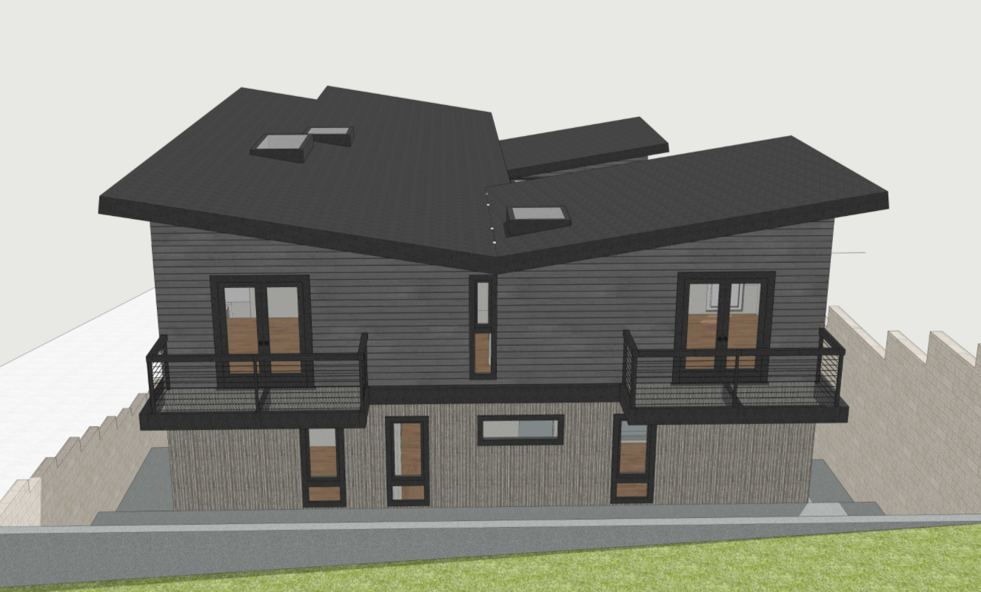
    Design Review – Lot Design
West (Rear) Elevation
Notes:
The rear of the home fronts onto a small backyard behind retaining walls.
With the rest of the lot, 23% being left in a natural state.
Although some will be lower, no retaining walls exceed the maximum permitted 6 ft in height.

Slide 8
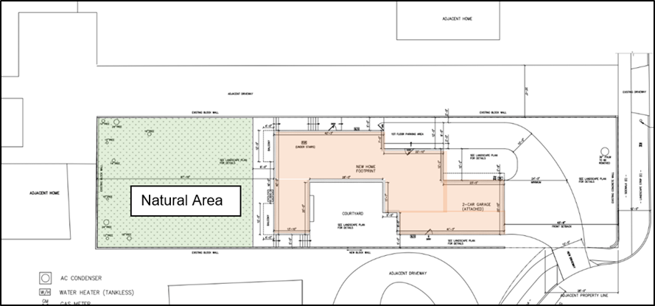
    Variance Request
Request: Reduce from Natural State requirement from 47.1% to 23%
Shallow slope of the site and the required height limits dictate use of a low stretched out design.
Infill of the site requires substantial grading to create a flat building pad.
Front yard although planted with California native plants will be graded and does not count as Natural State
Notes:
The Hillside Ordinance requires that a minimum of 25 percent of the lot area plus the percentage figure of the average slope must be remediated to its natural state for both slope and vegetation. With average slope of 22.1%, 47.1% of the site must remain in a natural state.
The applicant is requesting a variance to reduce the requirement to 23% of the lot area and has provided a detailed written narrative justifying this request.
He cites physical characteristics of the lot that restrict development, the shallow natural slope, the mound of artificial fill that extends from the street level up the hillside. In addition to the narrowness of the lot less than 50 feet wide on the west property line,
Staff supports the variance and believes that strict application of the natural state requirement will prevent the property owner from building a home with the same square footage and amenities as other homes in the neighborhood.
It should also be notted that in addition to the 23% area dedicated to natural state, the project is using California Native plants in the front yard setback and along a portion of the north side yard. Although the area will be graded, the use of native landscaping will partially meet the intent of the Hillside Protection Ordinance to preserve the natural hillside vegetation.
The main points of the applicant’s narrative are that:
Site is surrounded by developed single-family lots.
Site has accepted artificial fill which resulted in an artificial increase of the slope
Trees and plants on-site are invasive and non-native
The Biological Survey did not identify any plants or animals that should be protected;
Because the existing site is over a 20% average slope, this new home project is subject to the hillside standards, but the primary slope up from the street is less steep than other typical hillside projects.
In combination with some of the other Design Guidelines and Development Standards, the shallow slope causes other complications. The home is designed to fit in with the slope of the hillside and is more stretched out across the lot. A steeper hillside could accommodate a more compact and vertical design that is sunk into the hill, but the shallowness here necessitates a more stretched out home. This means the home takes up a larger percentage of the lot area than normal and the 47% of lot area needed for natural state cannot be reached
Despite applying for the variance for the reasons stated above, the site design still aims to maximize the natural state as much as possible
Staff concurs with the Applicant’s statements and recommends that the variance for the natural state is warranted

Slide 9
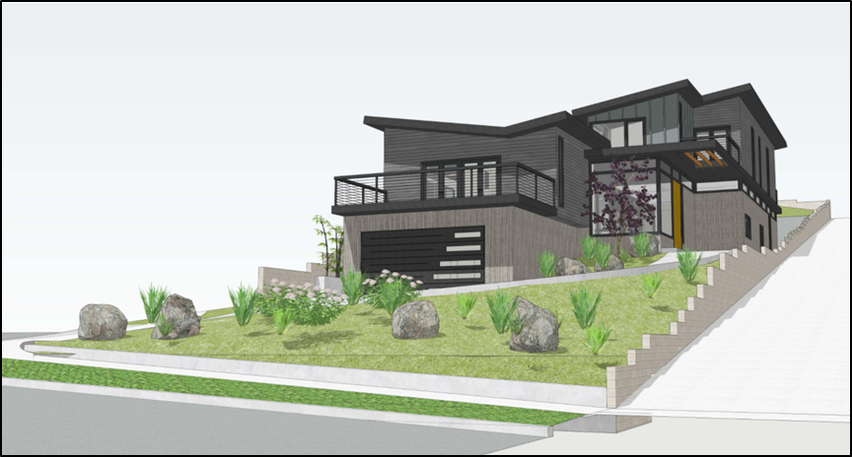
    Findings
    CEQA Review
Hillside Development Permit
Design Review
Variance
Categorical Exemption Section 15332- Class 32, In-Fill Development
Notes:
Entitlement Findings
In order to approve the Hillside Development Permit, Design Review and Variance for the property at 807 Rollin Street the Planning Commission must adopt specific findings with supporting evidence for each entitlement.
In reviewing the application staff determined that the Project meets all required findings
The findings and with supporting evidence are found in the resolution which is included as Attachment 1 of the staff report.
Findings are not required to adopt the Tree Removal Permit
Environmental Analysis
In accordance with the California Environmental Quality Act (CEQA), the project qualifies for a Categorical Exemption under Section 15332, Class 32 In-Fill Development projects
The findings and evidence supporting CEQA determination are also included in the resolution found in Attachment 1 of the staff report.
The project is consistent with the applicable General Plan designation and all applicable General Plan policies as well as with applicable zoning designation and regulations.
The proposed development occurs within city limits on a project site of no more than five acres substantially surrounded by urban uses.
The project site has no value as habitat for endangered, rare or threatened species.
Approval of the project would not result in any significant effects relating to traffic, noise, air quality, or water quality.
The site can be adequately served by all required utilities and public services.

Slide 10
    Staff Recommendation
Approve the Hillside Development Permit, Design Review, Variance, and Tree Removal Permit
    Planning Commission Options - Alternatives to Staff Recommendation:
Approve with modified/additional conditions
Continue the public hearing
Deny the project

Slide 11
Questions?
Notes:
This concludes staff presentation and staff stands ready to answer any questions you may have.

