Slide 1


Slide 2
    PROJECT DESCRIPTION
    Proposal: The applicant is seeking to delist (remove) their property at 822 Orange Grove Place from the City’s Inventory of Cultural Resources.

Slide 3
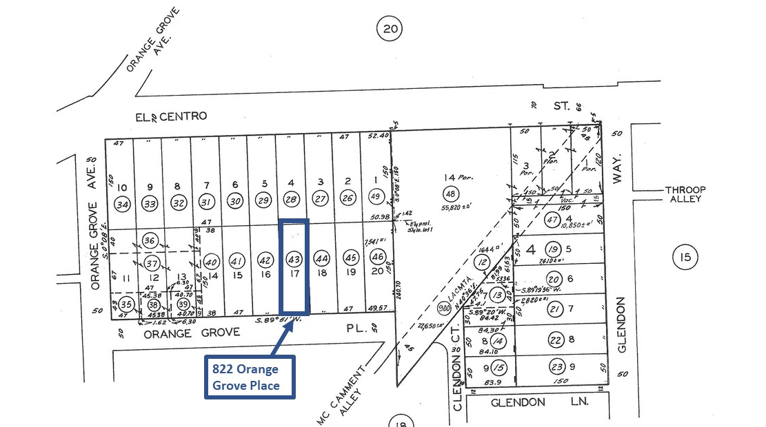
N

Slide 4
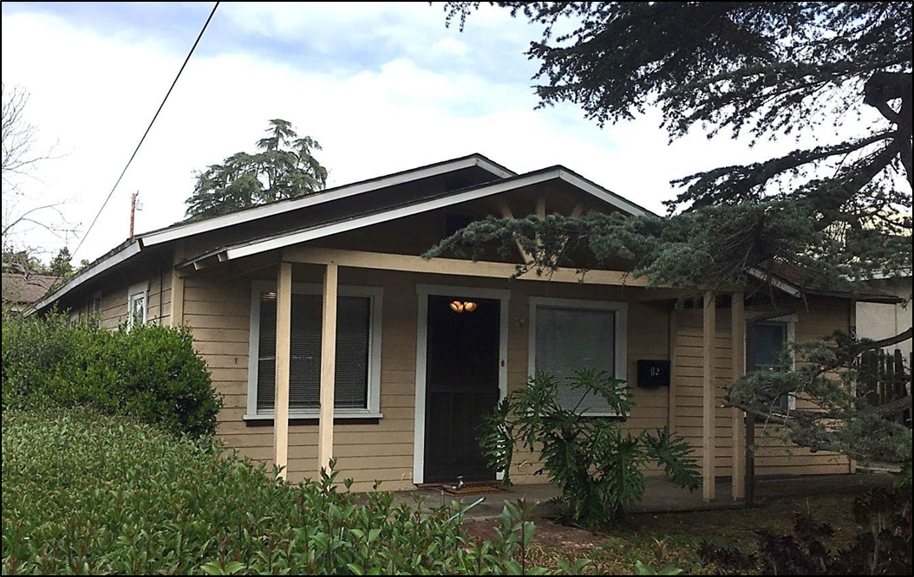

Slide 5
CHC RECOMMENDATION:
At its August 2020 meeting, the Cultural Heritage Commission voted 5-0 recommending that the City Council make the following findings pursuant to SPMC Section 2.64 for removal of properties from the Inventory of Cultural Resources:
That the cultural resource lacks significance as defined under national, state, and local criteria for historical significance.

Slide 6
Questions?

