Slide 2
Appeal
August 26, 2020 – Micah Haserjian submitted the appeal

Slide 3
Background History
March 10, 2020 –1st Planning Commission review. (Continued)
June 9, 2020 – Continuation request from Applicant and Staff
July 14, 2020 –2nd Planning Commission review. (Continued)
August 11, 2020 –3rd Planning Commission review. Passes 5-0.

Slide 4
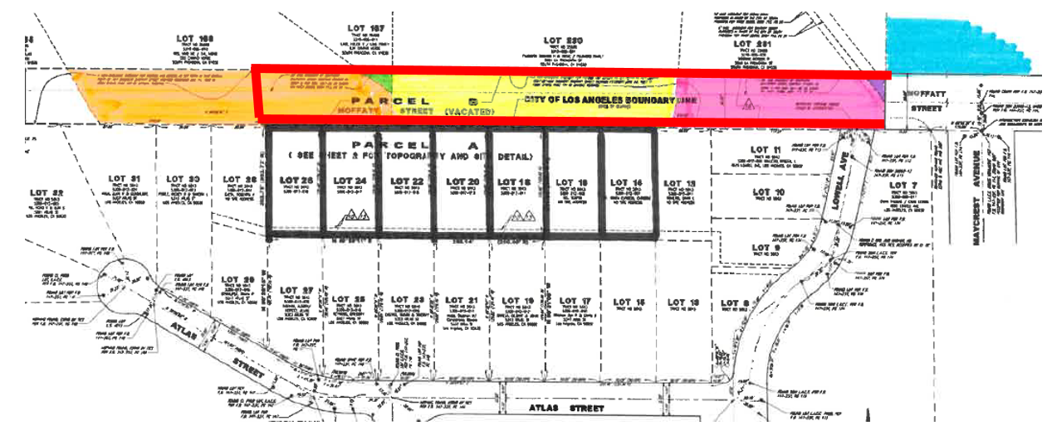
4519 Lowell Ave.
N

Slide 5
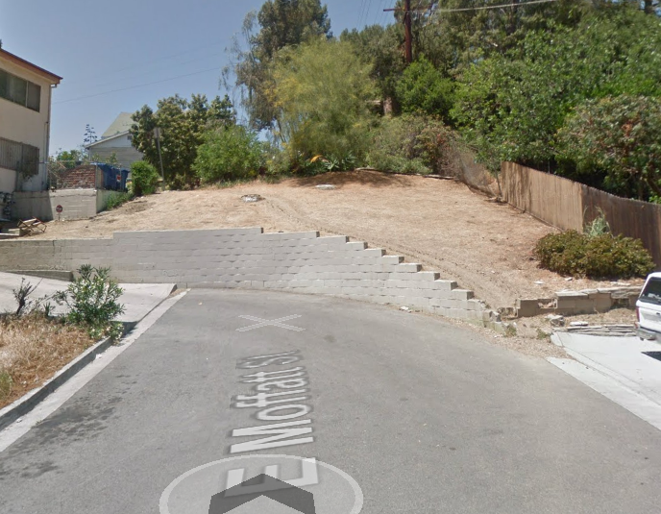

Slide 6
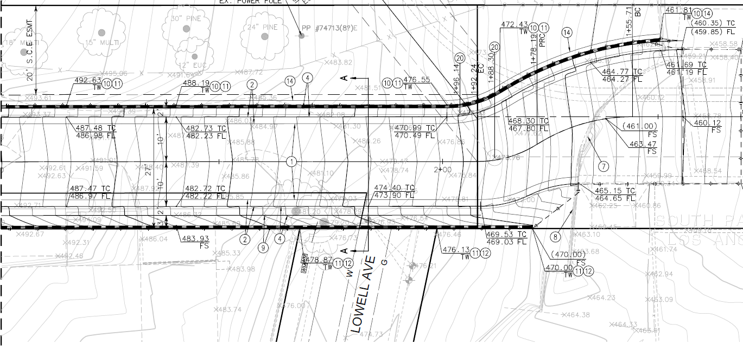
Previous Alternative Street Design

Slide 7
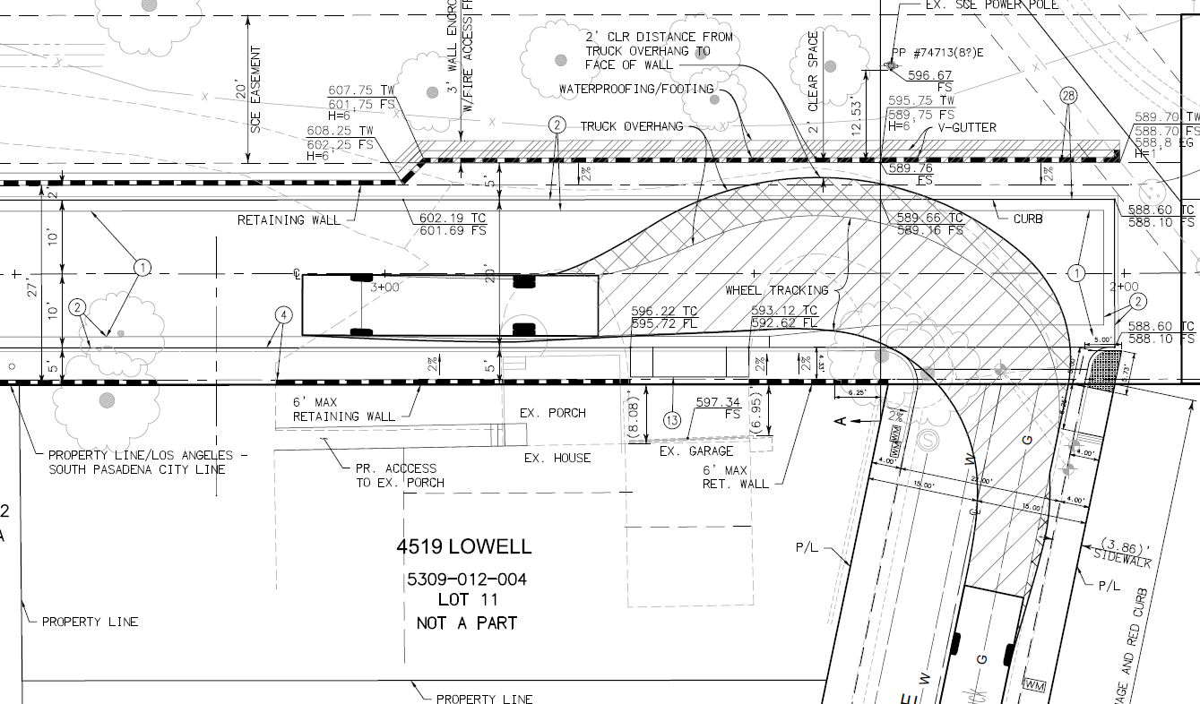
New Alternative Street Design
N

Slide 8
August 11, 2020 PC
Project passes 5-0
Questions from Commission:
Hook-ups to utilities for the new homes
Concern with CEQA and who’s the lead agency.

Slide 9
Issues Raised by Mr. Micah Haserjian
Concerned about developer rights to build the road on the easement
Concerned that the easement lies on 4 privately owned parcels.
Proposed street would be a burden to the neighborhood
Proposed street does not provide access to all 13 lots listed on the easement.
Disagreed with CEQA categorical exemption, class 3.
Concerned with no coordination with the City of Los Angeles on the connection to Lowell.
Project is detrimental to the environment & contributes to the housing crisis.
Concerned that approval is irresponsible to the community because of Covid-19 pandemic.

Slide 10
Staff Recommendation:
City Council uphold the Planning Commission’s approval of Project No. 2191-HDP/TRP

Slide 11
City Council Options:
Approve with additional condition(s) added; or
Send the project back to the PC; or
Deny the project.

Slide 12
Questions?

