Slide 1
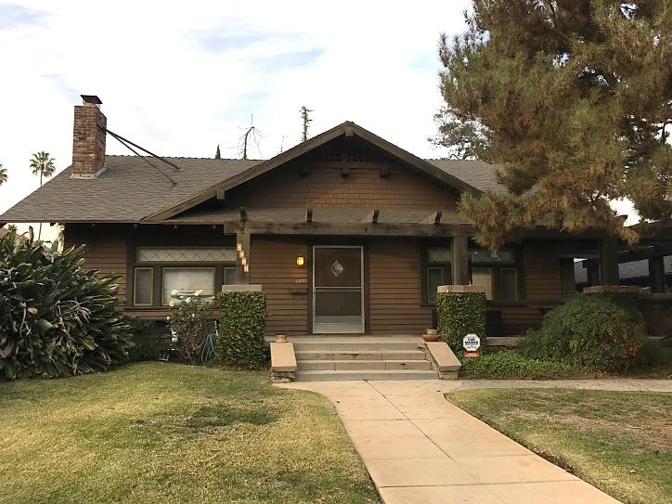
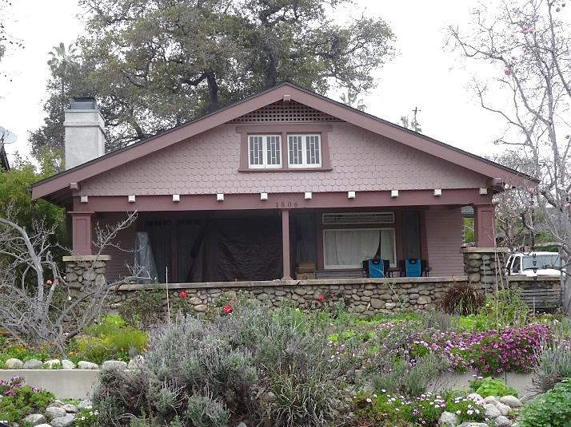
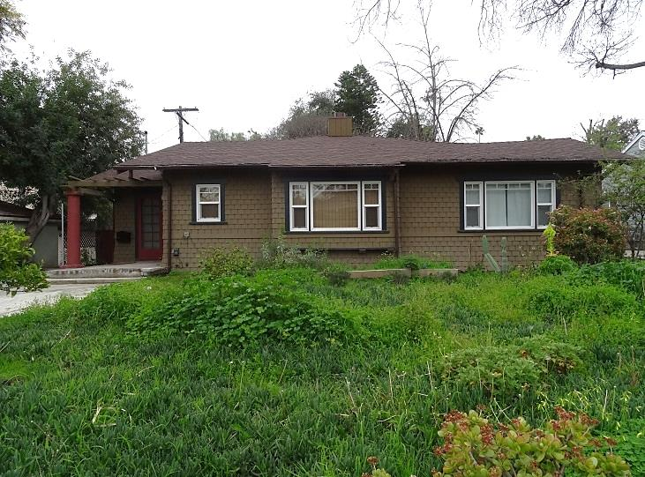
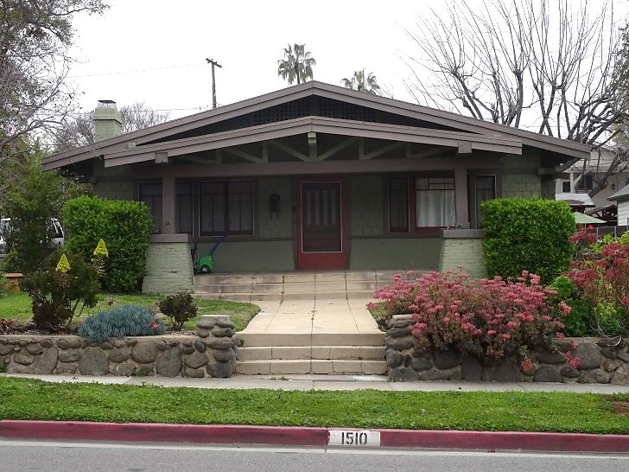
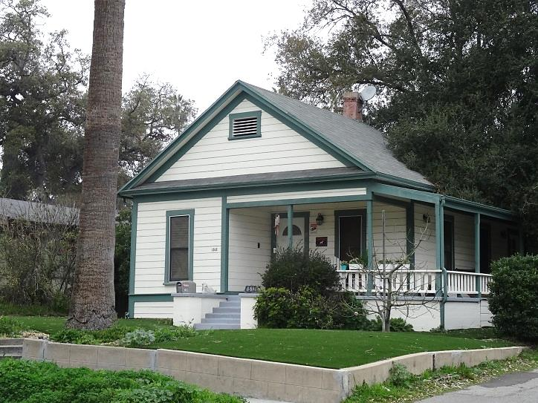
Rollin Craftsman Cluster Potential Historic District
1500 Rollin Street
1506 Rollin Street
1507 Rollin Street
1510 Rollin Street
1512 Rollin Street

Slide 2
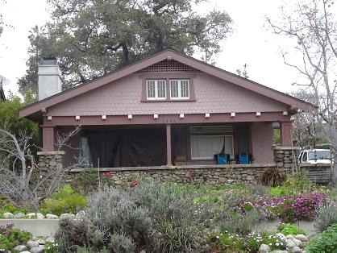
Rollin Craftsman Cluster Potential Historic District
The proposed Rollin Craftsman Cluster Historic District is significant as a distinguishable historic neighborhood related to the Early 20th Century Residential Development theme.
It is a good example of a neighborhood of modestly-sized Craftsman single-family residences, with a high degree of integrity. All five properties preserve a high level of authenticity and have undergone only minor alterations.
Its period of significance is from 1890 to 1914 which encompasses the earliest residence to the latest. It reflects planning and design principles from the period, including the original layout, street plan, setbacks, and sidewalks.

Slide 3
Rollin Craftsman Cluster Potential Historic District
All five properties are contributing and represent a range of character-defining features typical for the Vernacular and Craftsman Styles:
front porches with brick, stone, or wood piers and walls;
wood shingles and wood siding exterior cladding;
solid front doors with decorative lights;
overhang eaves, projecting rafters;
large tripartite windows with transom lights.
The first residents of this properties represented the early middle-class of South Pasadena community: their professions included a travel agent, a railway clerk, an elevator operator, and a plumbing supplies salesman.

Slide 4
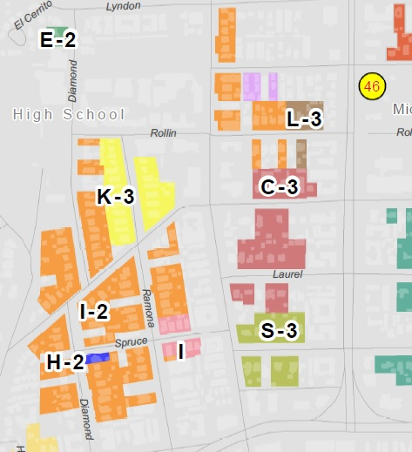
Rollin Craftsman Cluster Potential Historic District
L-3 – Rollin Craftsman
Cluster Potential Historic District
I-2 – High School Neighborhood Potential Historic District
C-3 – Oak/ Laurel
Historic District (designated)
K-3 – Ramona Craftsman Historic District (designated)
A fragment of the City of South Pasadena Historic Districts Map

Slide 5
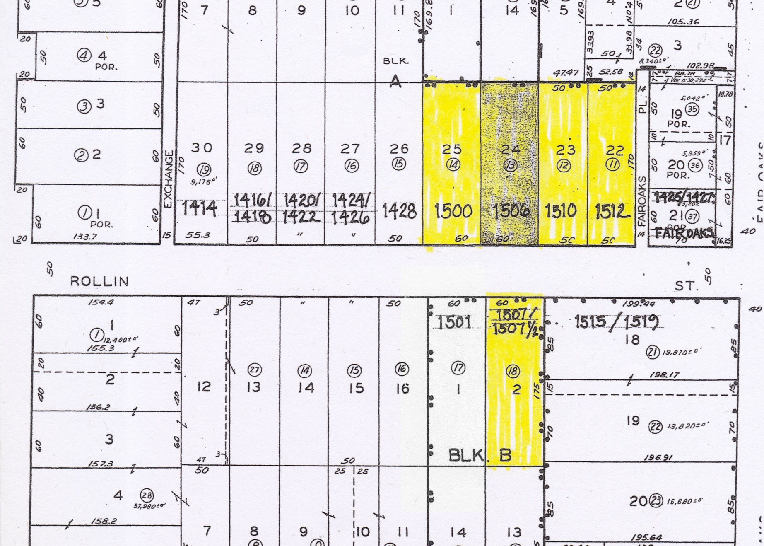
Rollin Craftsman Cluster Potential Historic District
Rollin Craftsman
Cluster Potential Historic District
1913
1909
1912
1924 As.
1940 As.
1909
1914
1890
1910
1913
1923 As.
High School Neighborhood Potential Historic District
1950
As.
1980 As.
1912
1938 As.
1921 As.
1922 As.
1969
As.
1914
Non-contributing
Exact dates are by the building permit; As. – per County Assessor

Slide 6
Rollin Craftsman Cluster Potential Historic District
1500 Rollin Street
1506 Rollin Street
1507 Rollin Street
1510 Rollin Street
1512 Rollin Street

