Slide 1


Slide 2
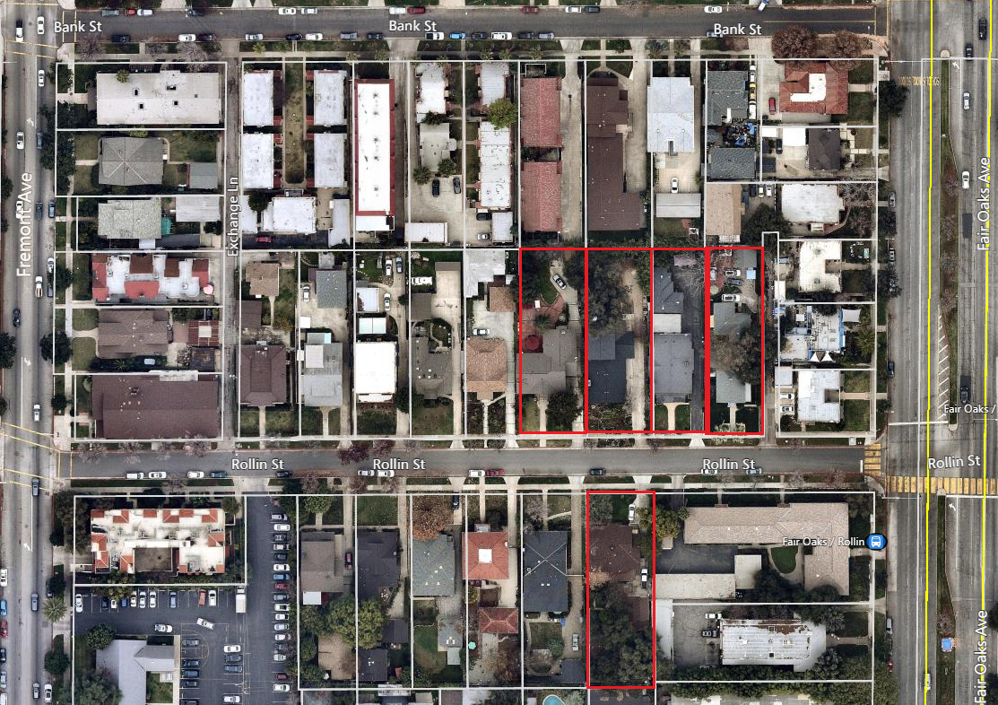
    PROJECT LOCATION
1500
1506
1512
1510
1507

Slide 3
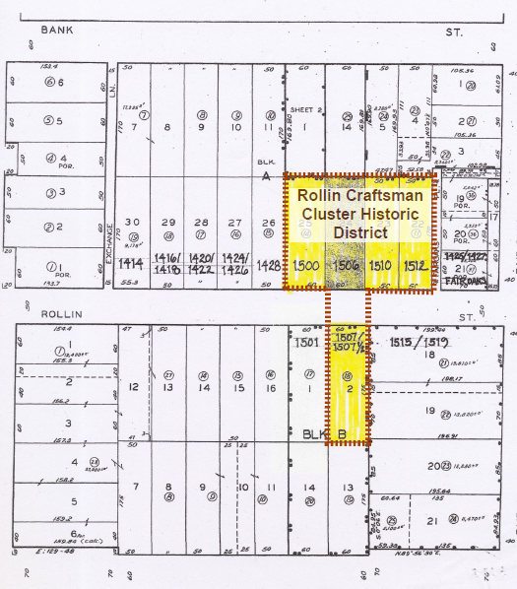
    District Boundary

Slide 4
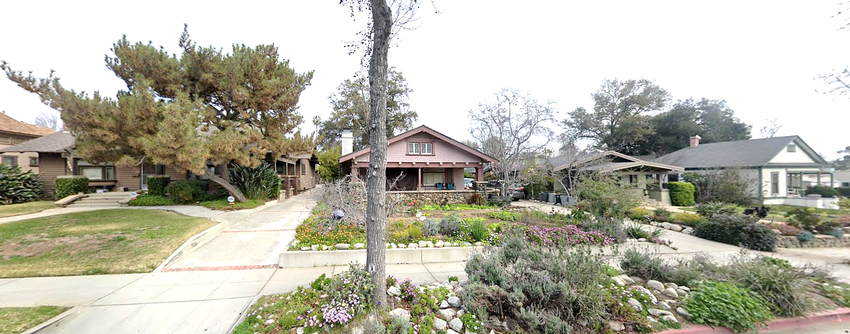
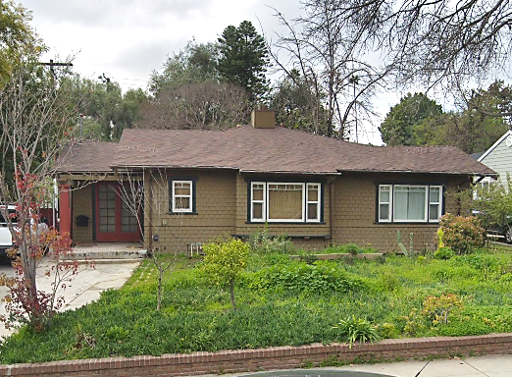

Slide 5
CRITERIA FOR HISTORIC DESIGNATION
The Context Statement Report states that the proposed Rollin Craftsman Cluster historic district qualifies for designation under criteria
(1), Its character, interest or value as a part of the heritage of the community;
(4) Its exemplification of a particular architectural style of an era of history of the city;
(7) Its embodiment of elements of outstanding attention to architectural design, engineering, detail design, detail, materials or craftsmanship;
(11) In designating a historic district, its significance as a distinguishable neighborhood or area whose components may lack individual distinction.

Slide 6
Recommendation: Cultural Heritage Commission recommended designation of the Rollin Craftsman Cluster Historic District to the City Council.

