Slide 1
Notes:
Good evening madam Mayor and Council members.

Slide 2
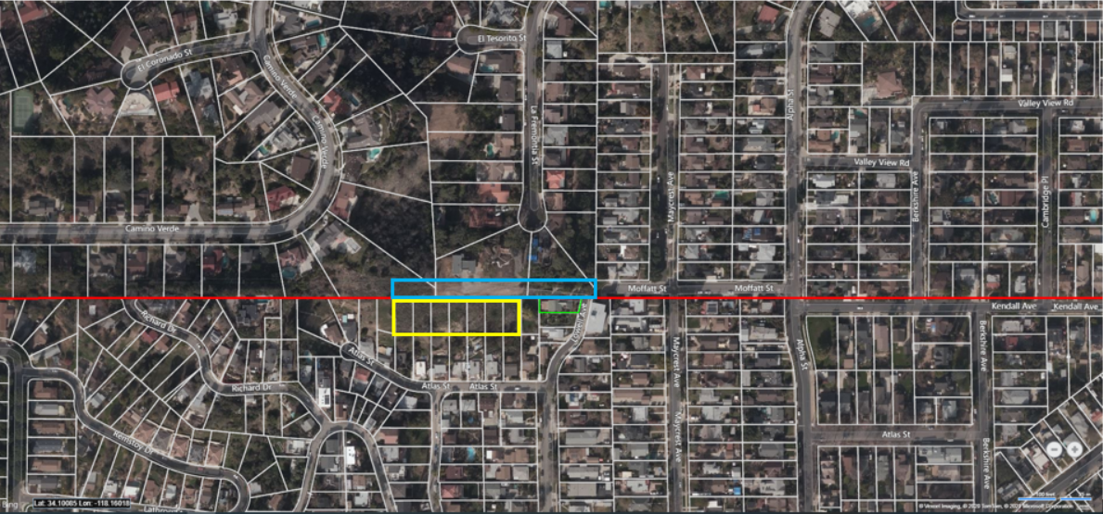
Project Location
Notes:
Here is an aerial image of the project site.
And the red line is the boundary for South Pasadena and Los Angeles
The easement area where the proposed private road will be installed is outlined in blue
The 7 residential lots in the City of Los Angeles that are owned by this applicant are outlined in yellow
The green outlined area of the property of the appeallant.

Slide 3
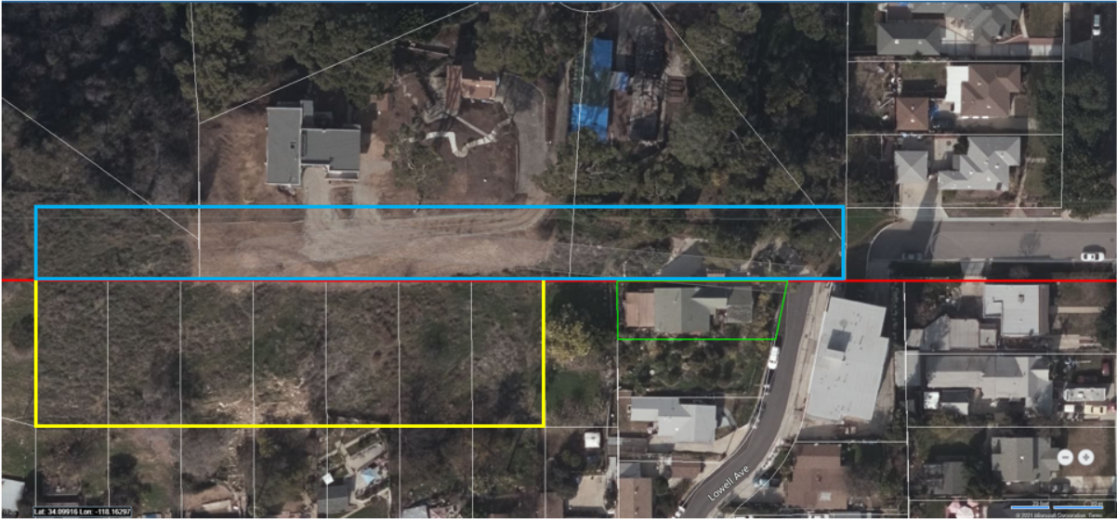
Project Site
Notes:
Here is a close up view of the earlier image.
As you can see here, the easement runs along the back of several properties in South Pasadena.

Slide 4
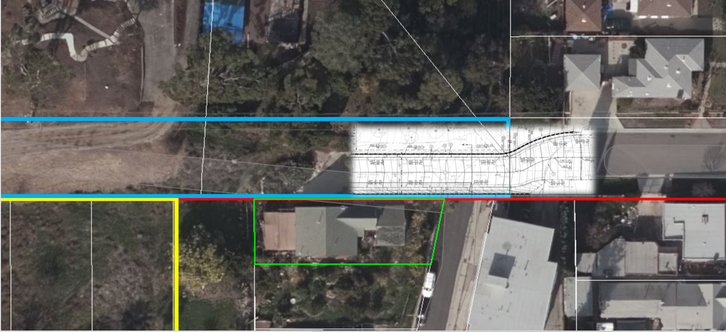
Original Street Design
Notes:
The image in white on this screen shows the original street design proposed by the applicant. This design would connect to the existing Moffatt street in our City and close of the access from Lowell Avenue in the City of Los Angeles.
This design requires grading of the existing public right-of-way on Moffatt, and all construction traffic and future residential traffic would have to use the public streets in our City to access the residential lots in the City of Los Angeles.

Slide 5
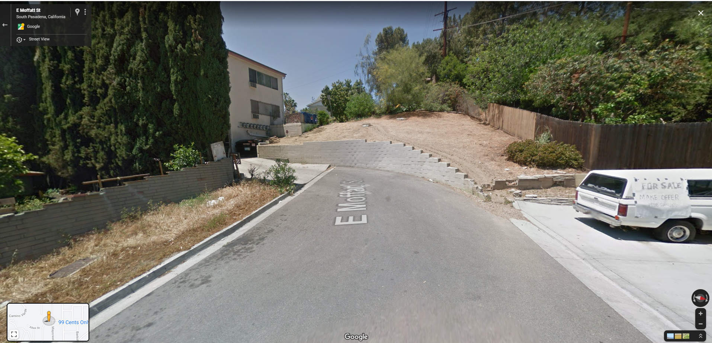
Moffatt Street
Notes:
Here is the existing condition of the public Moffatt street. The existing wall and dirt area above the wall would have to be removed and graded to accommodate the original street design.

Slide 6
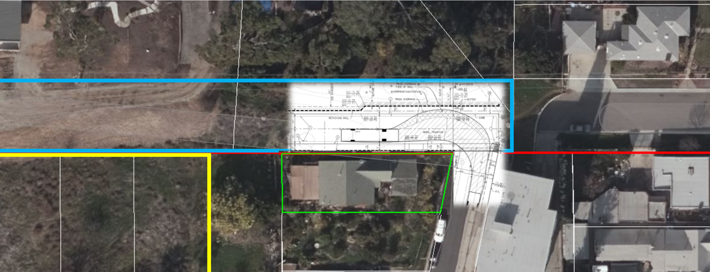
Approved Street Design
Notes:
After several meetings with the Planning Commission, the applicant agreed to change the street design to connect to Lowell Avenue, which is a public street in Los Angeles and no connection to our Moffatt Street. This design is better than the original design for several reasons, but the main reason is that this design will avoid construction and future residential traffic for properties in Los Angeles.

Slide 7
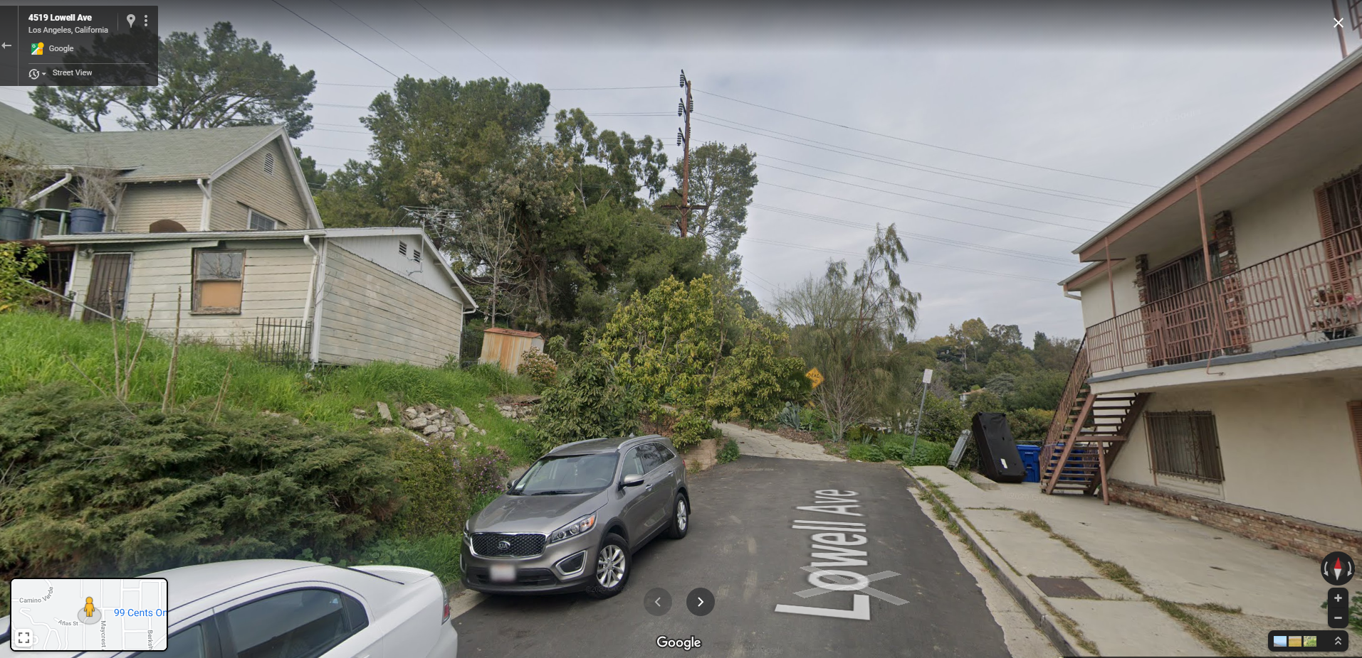
Lowell Avenue
Notes:
Here is the existing conditions on Lowell Avenue in the Los Angeles. The appellant resides on the property to left of Lowell Avenue in this image and they are currently access their property by a driveway on the access easement from Lowell Avenue. Therefore, the new design will continue to provide direct access to the appellant’s property as it currently does.

Slide 8
Past Council Meetings
October 21, 2020
November 18, 2020
Notes:
This item first went before the Council at the October 21, 2020 meeting and was continued to the November 18, 2020 meeting. Conditions of approval were revised to not allow the construction of the private street without the City of Los Angeles issuing the building permits for the homes.
At the November meeting, the Council voted 5-0 to continue the item after receiving a letter from Los Angeles County Supervisor, Hilda Solis, stating that the zoning of lots in El Sereno were to be re-evaluated later in 2020 through the Northeast Los Angeles Community Plan.
Staff met with City of Los Angeles staff on January 14, 2021 and County Supervisor Solis’ staff on January 27, 2021 to confirm the status of the Northeast Los Angeles Community Plan. The Community Plan will not proceed until mid-2022, and there is no plan to rezone the project-adjacent properties in Los Angeles as open space.

Slide 9
Staff Recommendation:
City Council uphold the Planning Commission’s approval of Project No. 2191-HDP/TRP

Slide 10
Questions?

