Slide 2
Past Council Meetings
October 21, 2020
November 18, 2020

Slide 3
Past Council Meetings (Continued)
February 17, 2021

Slide 4
Notice of Intent to File
Received on March 2, 2021

Slide 5
Overview of the Project

Slide 6
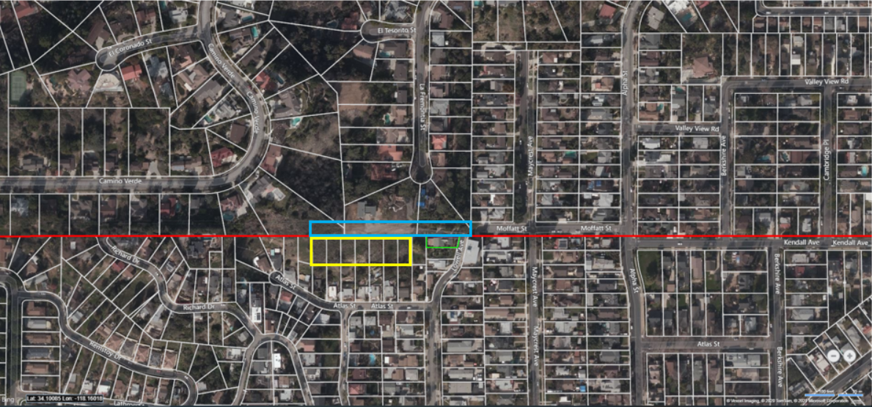
Project Location

Slide 7
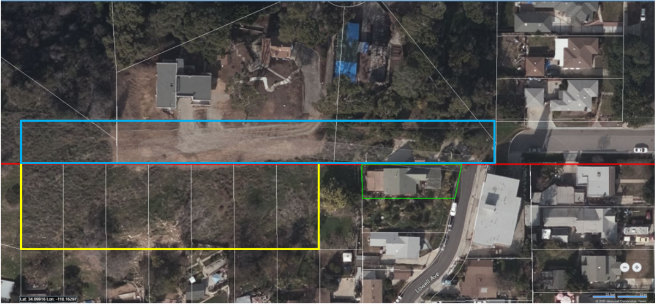
Project Site

Slide 8
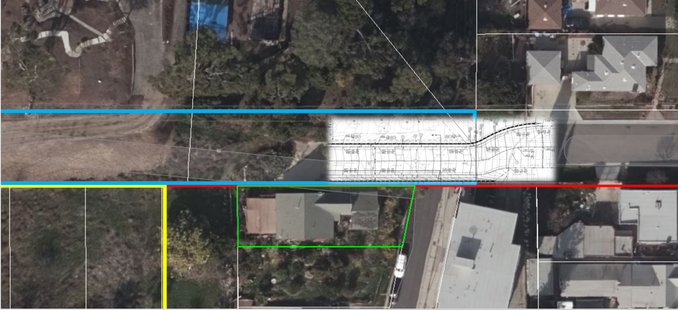
Original Street Design

Slide 9
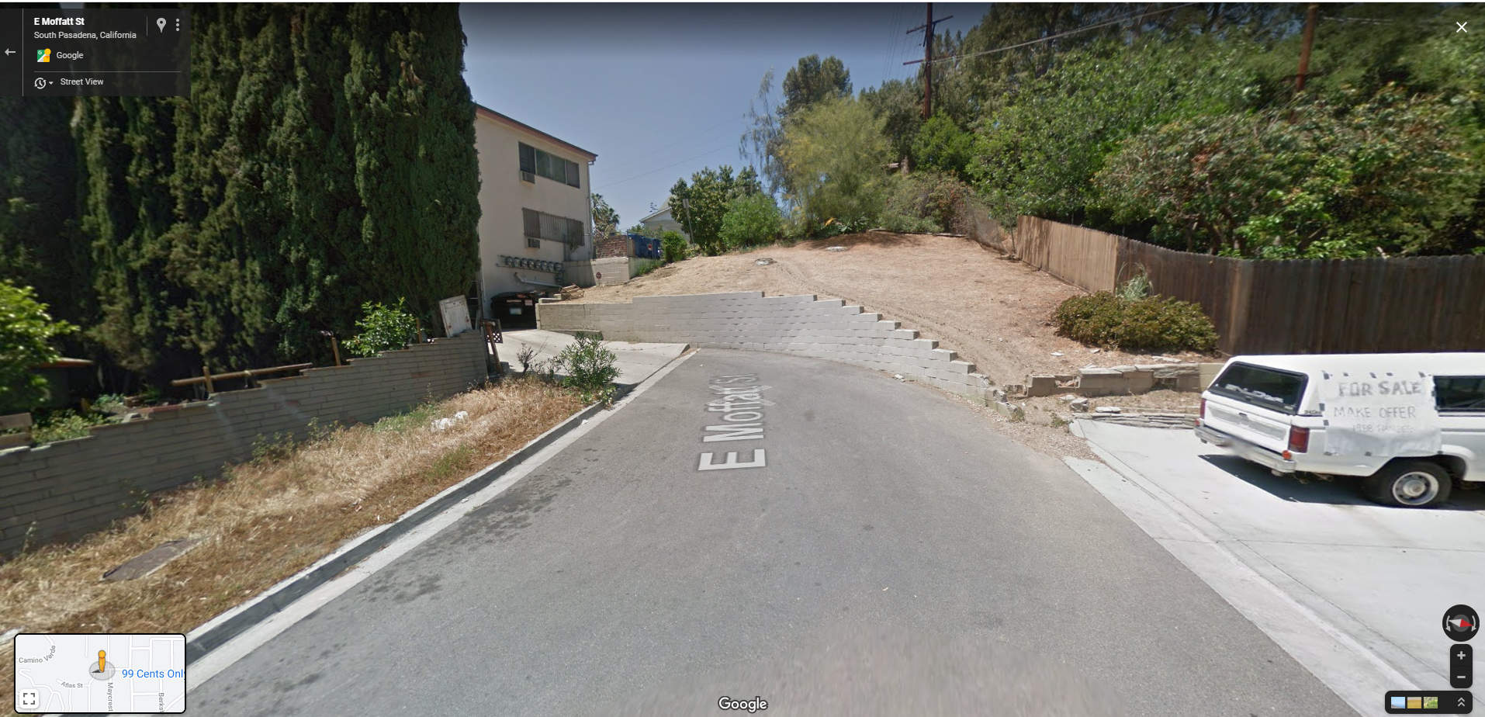
Moffatt Street

Slide 10
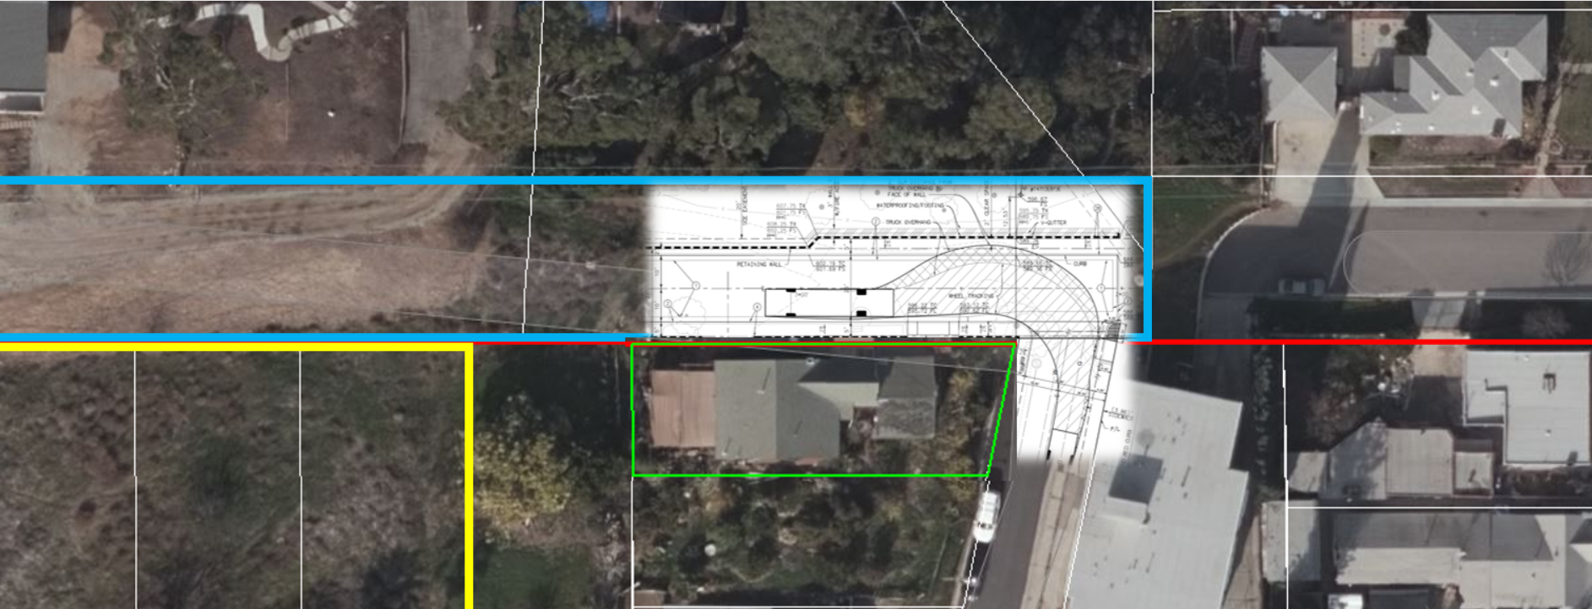
Approved Street Design

Slide 11
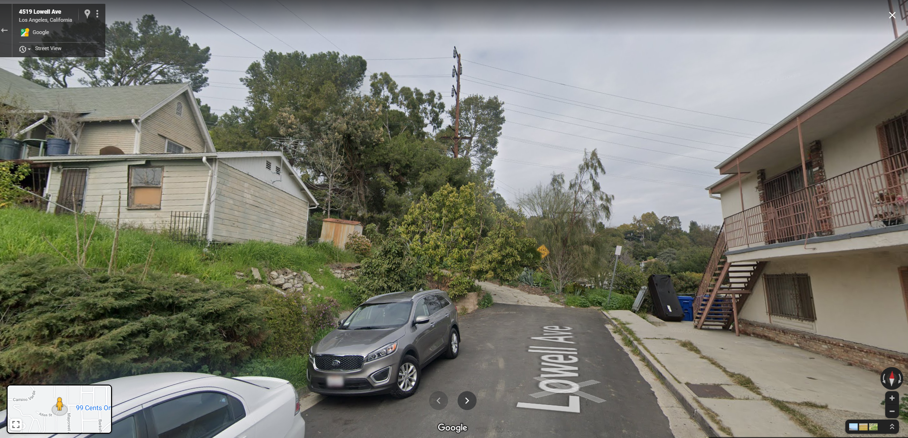
Lowell Avenue

Slide 12
Staff Recommendation:
City Council uphold the Planning Commission’s approval of Project No. 2191-HDP/TRP

Slide 13
Questions?

